Slide 1
Relational inductive biases, deep learning, and graph networks
Presented by Paul M Girdler and Chaitanya Pawa

Slide 2
Game
How many words are you able to form by adding one or more letters to the end of the words below?
Relation –
Induct –
Graph –

Slide 3
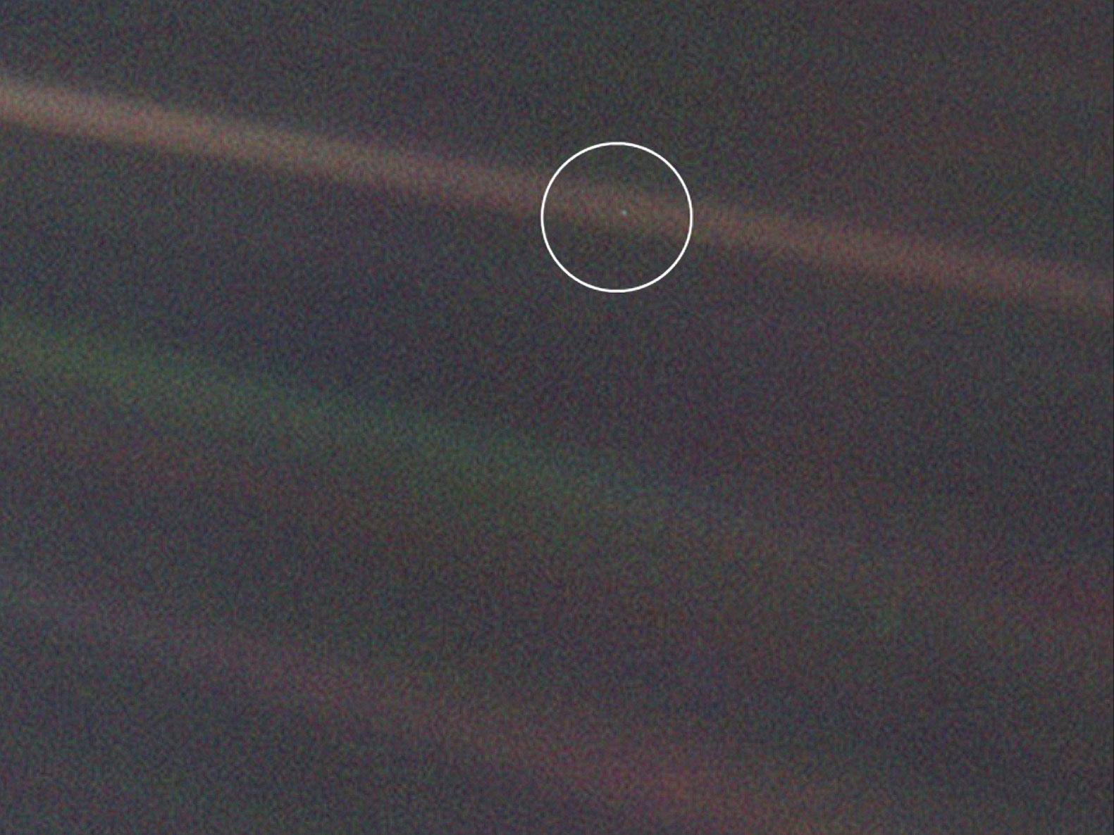
Challenge
Be curious, explore, discover…

Slide 4
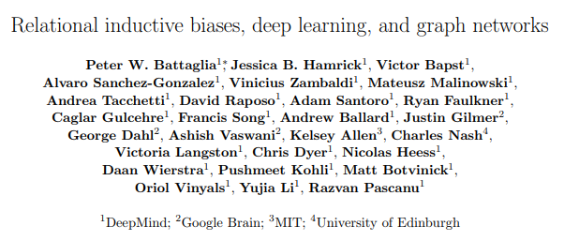




Paper
Frame the situation
Paper: “part position paper, part review, and part unification.”
Authors: 27 of the best in the from diverse fields, backed by 4 research heavy weights.
Mission: “Solve intelligence.”(DeepMind)

Slide 5
A key signature of human intelligence is the ability to make “infinite use of finite means”
THE GOAL
Combinatorial Generalization
“We argue that combinatorial generalization must be a top priority for AI to achieve human-like abilities, and that structured representation and computations are key to realizing this objective.”
(Humboldt, 1836; Chomsky, 1965)

Slide 6
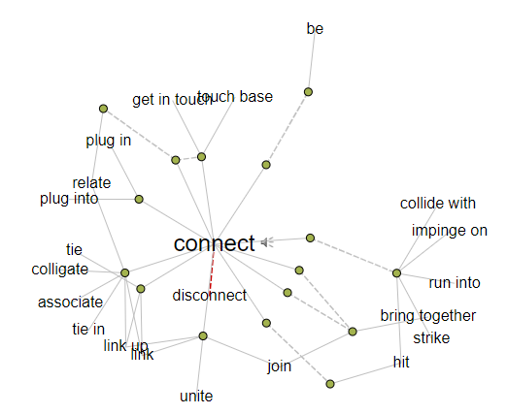
Combinatorial Generalization - Example
Relation
Relations
Relationship
Relationships
Relate
Related
Relative
Relatives
Relatively
Connection
Connections
Connected
Connectedness
Connective
Connectivity

Slide 7
… the world is compositional, or at least, we understand it in compositional terms. When learning, we either fit new knowledge into our existing structured representations, or adjust the structure itself to better accommodate (and make use of ) the new and the old.
Relational Reasoning
Involves manipulating structured representations of entities and relations, using rules for how they can be composed.
Structure
Product of composing a set of known building blocks.
(Humboldt, 1836; Chomsky, 1965)

Slide 8
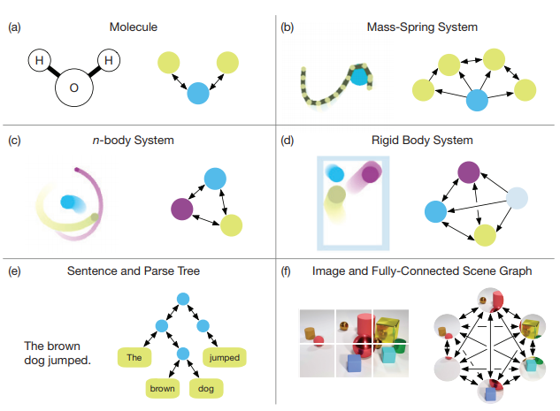
Relational Reasoning
Table – Building Blocks of Relational Reasoning
Figure - Different Graph Representations
Building Blocks | Definition
ENTITY | An entity is an element with attributes.
RELATION | A relation is a property between entities.
RULE | A rule is a function that maps entities and relations to other entities and relations.

Slide 9
How can one use relational reasoning for the goal of combinatorial generalization?
THE GOAL
Combinatorial Generalization
“We argue that combinatorial generalization must be a top priority for AI to achieve human-like abilities, and that structured representation and computations are key to realizing this objective.”

Slide 10
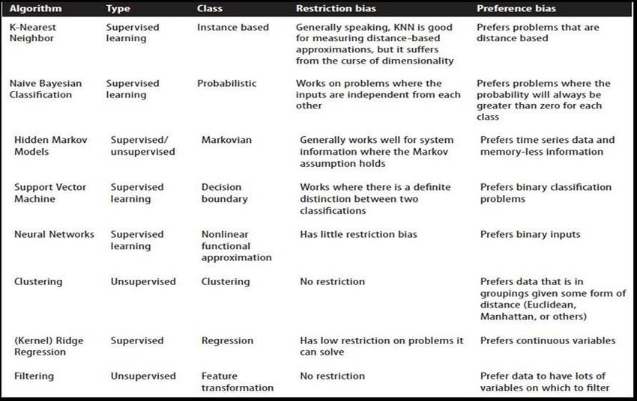
Inductive Biases - Overview
Inductive biases can express assumptions about either the data-generating process or the space of solutions.
An inductive bias allows a learning algorithm to prioritize one solution (or interpretation) over another, independent of the observed data.
Relational inductive biases impose constraints on relationships and interactions among entities in a learning process.
Gheisari, Mehdi & Wang, Guojun & Bhuiyan, Md Zakirul Alam. (2017). A Survey on Deep Learning in Big Data. 173-180. 10.1109/CSE-EUC.2017.215.

Slide 11
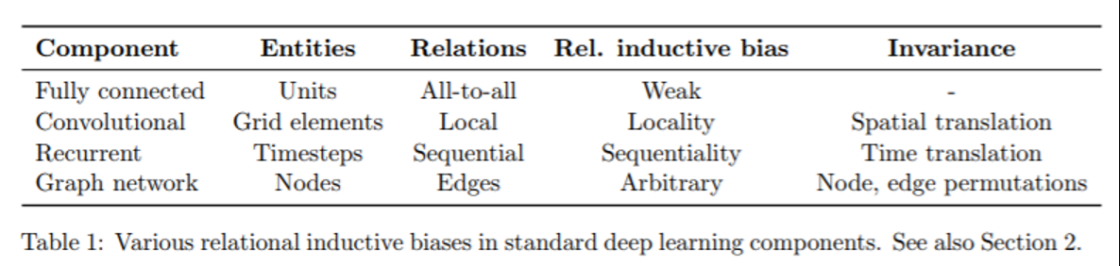
Inductive Biases – Deep Learning
Table - Inductive Biases in Deep Learning

Slide 12
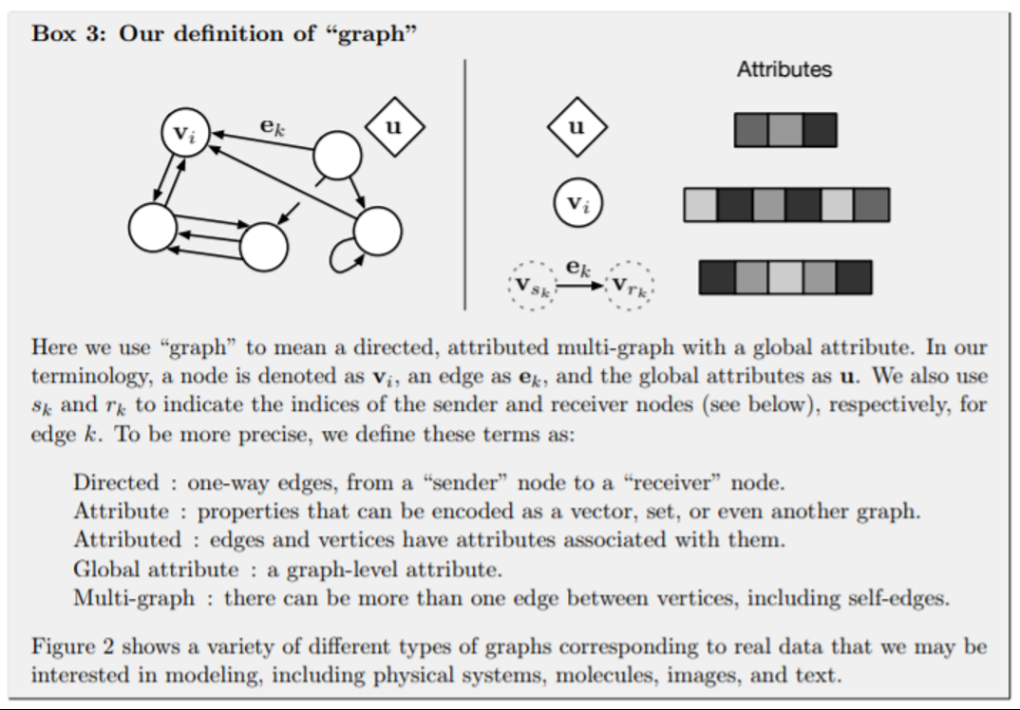
Graph Networks - Overview
DeepMind’s Position
Examples of Graph Representations

Slide 13

This is nice, but what about the algorithm?

Slide 14
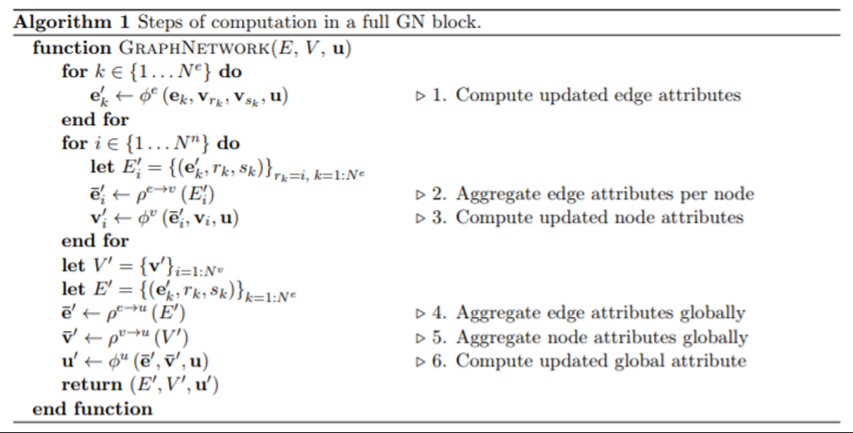
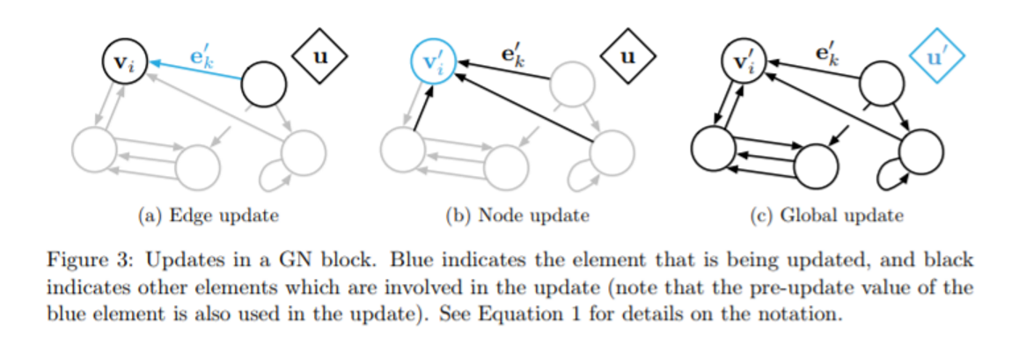
Graph Network - Algorithm

Slide 15
Okay… But does it work?!

Slide 16
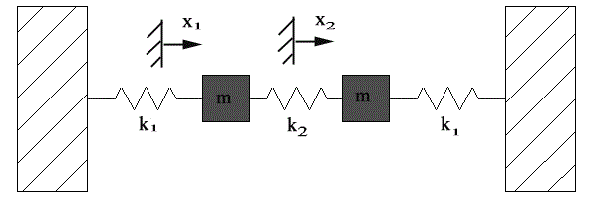
Experiment - Overview
Aim: To investigate the generalization ability of the Graph Nets algorithm.
Method:
Choose a dataset with known and fixed relationships.
Train the GN over an interval.
Test the GN outside of this interval.
Model Description:
Trains a GN to predict the state of the random mass-spring physical systems on the next time-step.
The model’s next-step predictions can be fed back in as input to create a rollout of a future trajectory.

Slide 17
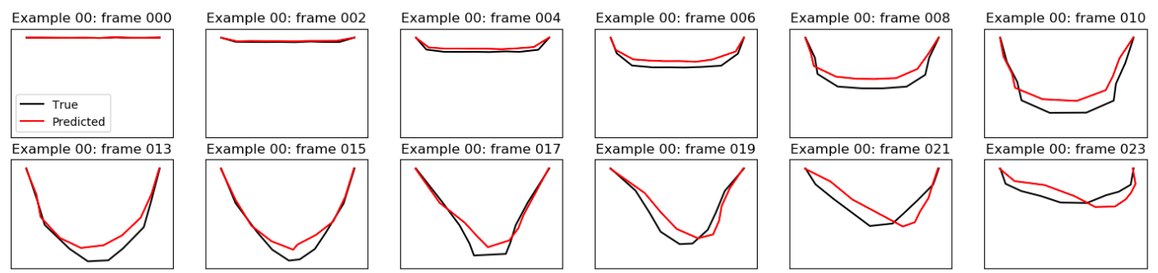
Experiment - Results
Figure – Example rollout of mass-spring system pinned at ends (Generalized)

Slide 18
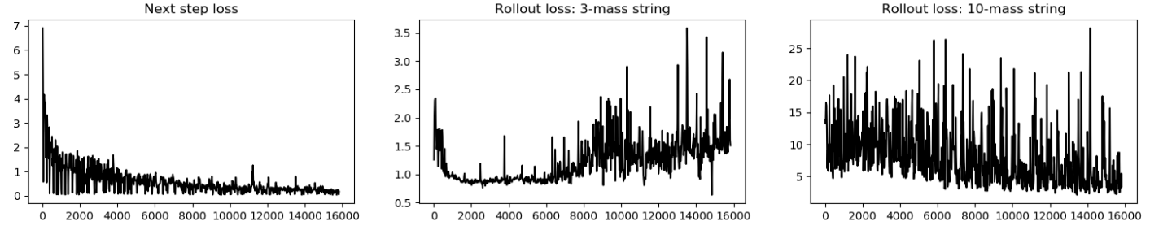
Experiment - Results
Figure – Next step / Rollout loss of mass-spring system pinned at ends (Generalized)

Slide 19
Strengths and Limitations
Strengths
Combinatorial generalization
Does more with less data
Reflects a human model for understanding and reasoning
Limitations
Recursion, control flow and conditional iteration are not straightforward
Open Questions
How to generate the graphs?
How to modify graphs during computation?

Slide 20
Conclusion
This is the start of the journey…

